Slide 1

Calendar App
Meeting with Cresswell, Todd-20250504_172309-Meeting Recording.mp4
Todd Cresswell

Slide 2

Problem statement
Develop a calendar that allows the user to add, edit, and delete events from the calendar

Slide 3
solution statement
Implement render and vs code to develop the front and back end of the calendar app.

Slide 4
Challenges
Setting up log in before the user sees the calendar.
Having the events show up in the calendar
Setting up the CRUD functions namely delete and edit(edit not fully integrated).
Setting up the Todo list(had to remove the feature)
Time Management

Slide 5
highlights
Developing the back-end server
Getting the events to show up in the calendar and allow the user to click the event to delete the event.
Setting up Authentication

Slide 6
tools
VS code-developing
Render-hosting the server and the site
MongoDB-host the database

Slide 7
Development process
Steps to develop the app
Back-end server and schemas
Integrate a MongoDB database
Test on Postman
Develop Front-end

Slide 8
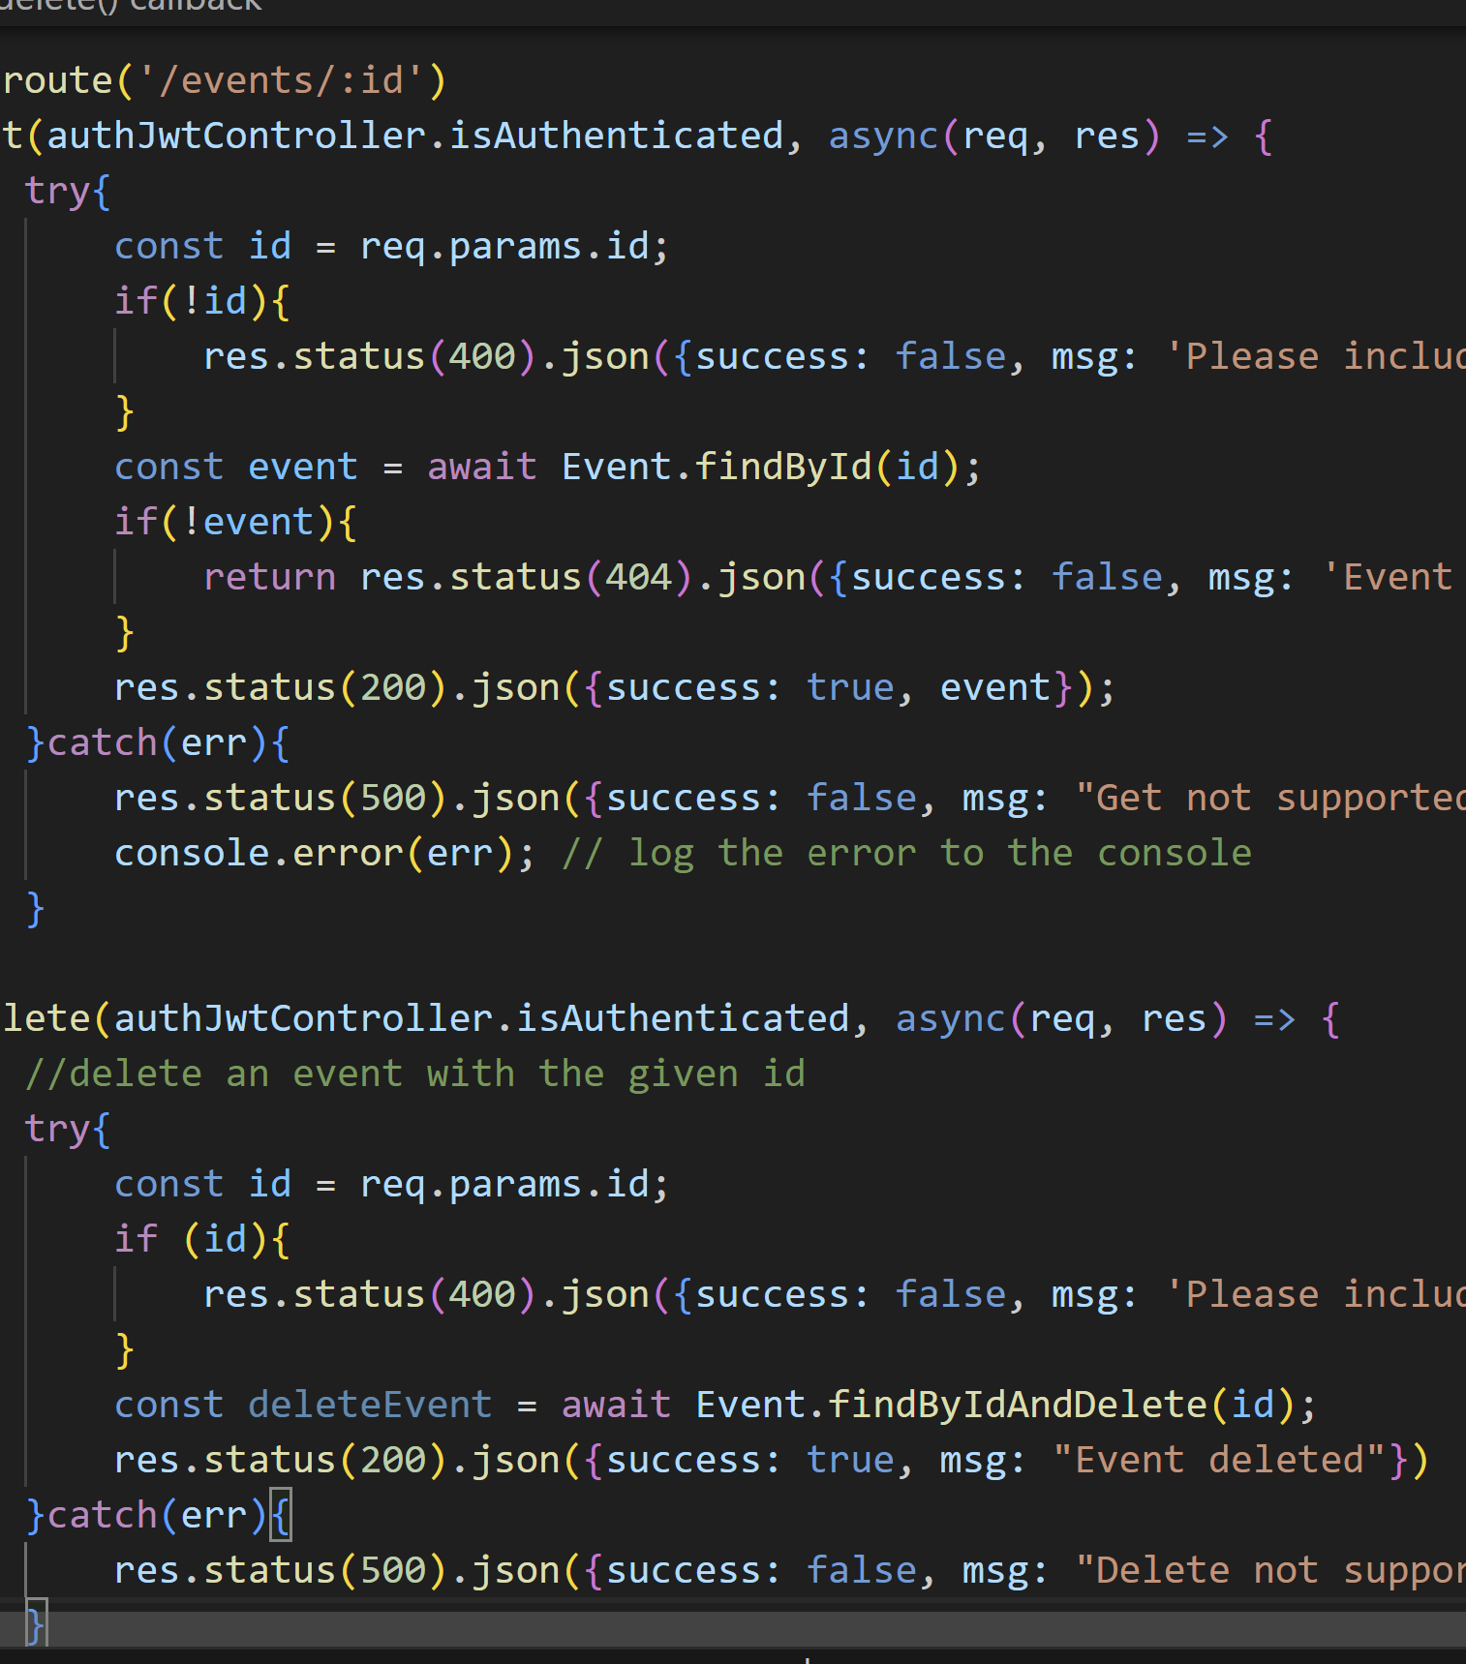
Back-end
Set up event and user schema
Server set up
Routes
Sign up
Sign in
Event
Event/eventid

Slide 9
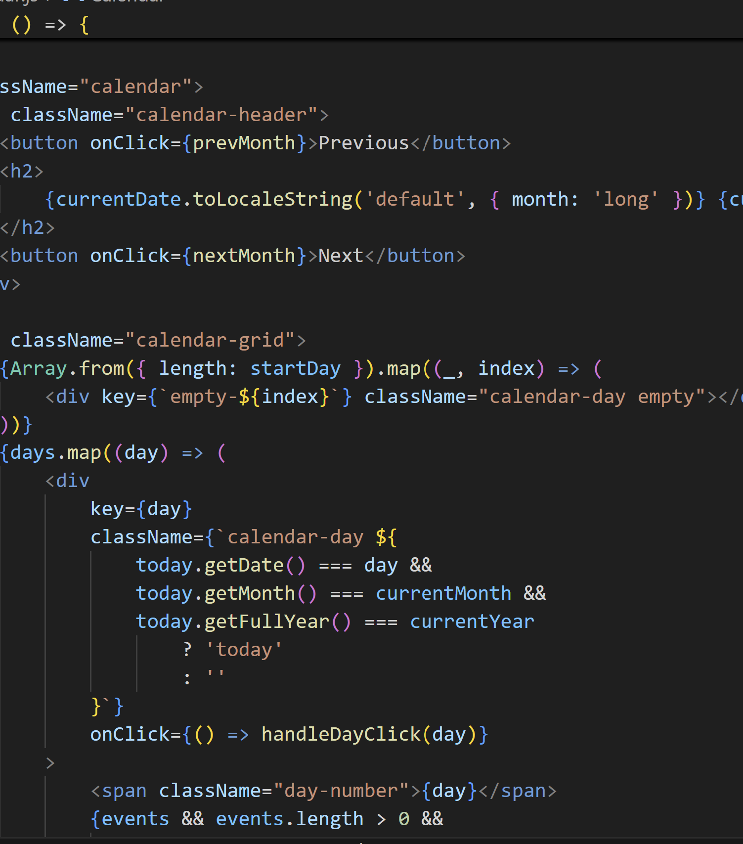
Front end
Components:
Calendar
Authentication
Event Details
Event Form
Headers
Login
Register

Slide 10
Demo
https://react-calender-app-0tr1.onrender.com

Slide 11
Future
Add the edit functionality
Integrate a Todo list
Cross platform
Improve UI

Slide 12
Githubs
Back end: https://github.com/Tcress1993/CSCI_3916_final_project.git
Front end: https://github.com/Tcress1993/react_Calender_app.git

